Slide 1
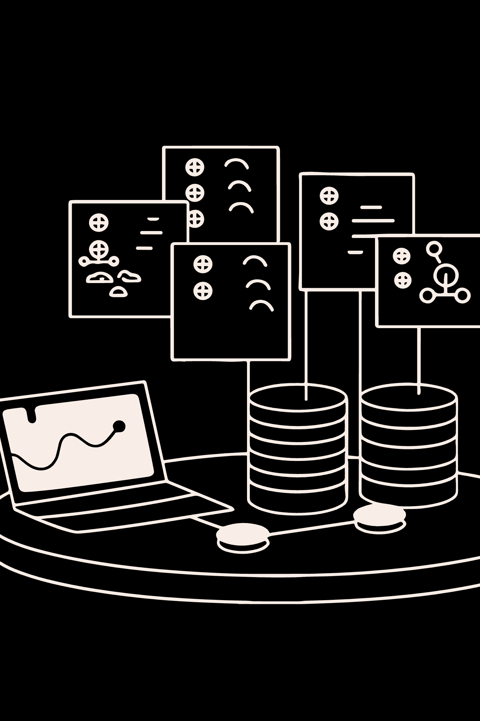
B.TECH AI & DS MINI PROJECT
Support Ticket System
K. Bhavana · Artificial Intelligence & Data Science Department
Annamacharya Institute of Technology and Sciences (AITS), Tirupati

Slide 2

INTRODUCTION
What Is a Support Ticket System?
A Support Ticket System is a structured digital platform that enables users to report, track, and resolve issues in an organized manner. Instead of relying on informal communication channels like email or phone calls, users submit formal tickets that are logged, prioritized, and managed through a centralized interface.
Issue Reporting
Centralized Tracking
Users submit detailed descriptions of their problems, ensuring nothing is lost or overlooked in the support process.
All tickets are stored in a single system, giving both users and administrators full visibility into open, pending, and resolved issues.
Structured Resolution
Tickets follow a defined lifecycle — from creation through review to resolution — ensuring accountability and timely closure.

Slide 3

PROBLEM STATEMENT
The Challenge with Manual Support
Traditional, manual approaches to handling user support requests are increasingly inadequate in modern, fast-paced environments. Without a structured system, organizations face critical operational gaps that directly impact user satisfaction and team productivity.
Inefficient Manual Handling
Difficulty Tracking User Issues
Lack of Centralized Management
Support requests received via email or verbal communication are prone to being missed, duplicated, or delayed. There is no standardized process for logging or escalating issues.
Without a centralized record, it becomes nearly impossible to track the status of individual requests, leading to unresolved tickets and frustrated users who receive no updates.
Administrators have no unified dashboard to oversee all active tickets, assign priorities, or measure team performance — making it difficult to maintain service quality at scale.

Slide 4




OBJECTIVES
Project Objectives
This project aims to address the inefficiencies of manual support handling by developing a full-stack web application that streamlines the entire ticket lifecycle — from submission to resolution.
Create & Manage Tickets
Track Ticket Status
Enable users to submit support tickets with title, description, and priority level through an intuitive interface.
Provide real-time visibility into ticket progress — Open, In Progress, or Resolved — for both users and admins.
Improve Resolution Process
Maintain Ticket History
Streamline admin workflows with a dedicated dashboard for reviewing, updating, and closing tickets efficiently.
Preserve a complete audit trail of all tickets, enabling trend analysis and accountability over time.

Slide 5
TECHNOLOGIES
Technology Stack
The Support Ticket System is built on a modern, full-stack JavaScript ecosystem, ensuring fast performance, scalability, and a seamless developer experience.
Frontend
Backend & Infrastructure
Next.js — React-based framework for server-rendered, SEO-friendly pages
React.js — Component-driven UI library for dynamic interfaces
Tailwind CSS — Utility-first CSS framework for rapid, responsive styling
Node.js — JavaScript runtime for building scalable server-side applications
Express.js — Lightweight web framework for RESTful API development
MongoDB Atlas — Cloud-hosted NoSQL database for flexible document storage
GitHub — Version control and collaborative development platform

Slide 6
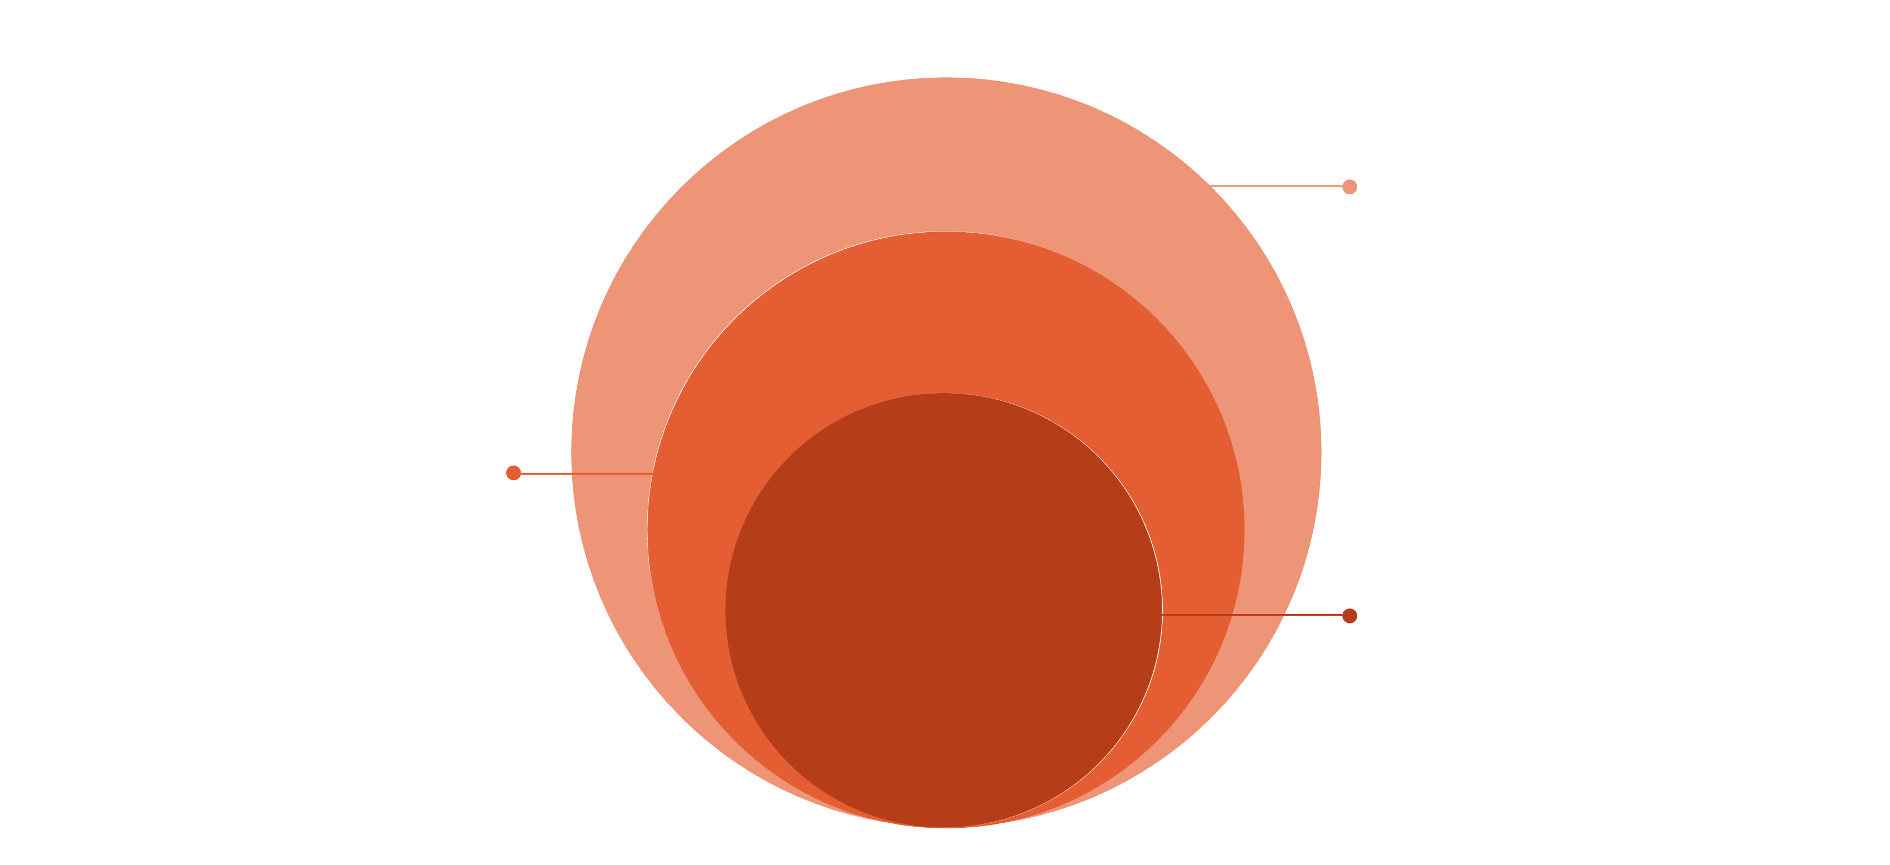
ARCHITECTURE
System Architecture
The application follows a classic three-tier architecture, separating concerns between the client, server, and data layers for maintainability and scalability.
Backend & Data
Node.js/Express API → MongoDB Atlas
Frontend Layer
Next.js + React + Tailwind CSS
User Browser
Client interacts via browser UI
The User interacts with the Next.js Frontend, which sends API requests to the Express.js Backend. The backend processes business logic and communicates with MongoDB Atlas to persist and retrieve data. This separation ensures clean code organization and easy future scaling.

Slide 7
DATABASE DESIGN
Database Schema
MongoDB Atlas stores all application data across two primary collections — Users and Tickets — designed for fast queries and flexible document structures.
Users Collection
Tickets Collection
User ID — Unique identifier (auto-generated)
Name — Full name of the user
Email — Unique email for login and notifications
Password — Hashed credentials for secure authentication
Ticket ID — Unique identifier for each ticket
Title — Brief subject line summarizing the issue
Description — Detailed explanation of the problem
Priority — Low / Medium / High classification
Status — Open / In Progress / Resolved
Created Date — Timestamp of ticket submission

Slide 8
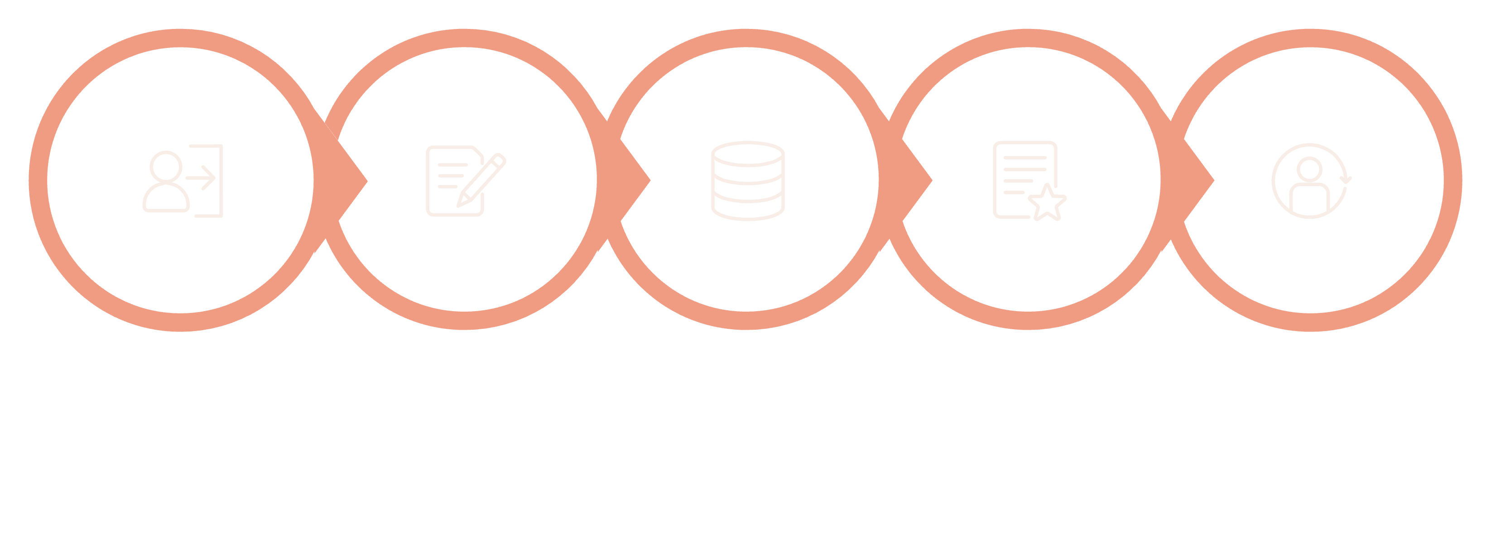
MODULES & WORKFLOW
Core Modules & Ticket Workflow
The system is organized into six functional modules, each serving a distinct role in the user or admin experience. Together, they support a seamless end-to-end ticket lifecycle.
01
02
User Authentication
Create Ticket
Secure login and registration with session management.
Users submit tickets with title, description, and priority.
03
04
My Tickets
Ticket Details
Personalized view of all tickets submitted by the user.
Full ticket view with status, priority, and history.
05
06
Admin Dashboard
Ticket Management
Centralized panel for admins to oversee all tickets.
Admins update status, assign priority, and resolve issues.
Store in MongoDB
User Login
Create Ticket
Admin Review
Status Updated
Once a user logs in and submits a ticket, it is immediately persisted in MongoDB. Admins are notified, review the ticket, update its status, and mark it resolved — completing a transparent, auditable workflow.

Slide 9





FEATURES & ADVANTAGES
Key Features & Advantages
The Support Ticket System delivers a comprehensive set of features designed to maximize usability, efficiency, and administrative control — resulting in measurable improvements over manual processes.
Responsive Design
Search & Filter
Fully adaptive UI that works seamlessly across desktops, tablets, and mobile devices using Tailwind CSS breakpoints.
Users and admins can quickly locate tickets using keyword search, priority filters, and status-based sorting.
Dashboard Statistics
Priority & Status Management
Admin dashboard displays real-time metrics — total tickets, resolved count, pending issues, and priority distribution.
Tickets are classified by priority (Low/Medium/High) and tracked through a clear status lifecycle for better triage.
Key Advantages: Easy issue tracking · Faster support resolution · Improved team productivity · Centralized, auditable ticket management

Slide 10
FUTURE SCOPE & CONCLUSION
Future Enhancements & Conclusion
Planned Enhancements
Conclusion
Email Notifications — Automated alerts for ticket updates and resolutions
File Attachments — Allow users to upload screenshots or documents
AI Chatbot Support — Intelligent auto-responses for common queries
Ticket Assignment — Route tickets to specific support agents
Analytics Dashboard — Advanced reporting and trend visualization
This project successfully demonstrates the development of a fully functional Support Ticket System using modern web technologies — Next.js, React, Node.js, Express, and MongoDB Atlas.
The system effectively addresses the core challenges of manual support handling by providing a centralized, trackable, and efficient platform for issue management. It showcases practical application of full-stack development principles within the AI & DS curriculum.
K. Bhavana · AI & DS Department · AITS, Tirupati
Thank you — Questions & Answers

